Slide 1


Delicate Information Exchange among representative and authority (Network Security) Batch A23

Slide 2

Team Details
Gayathri S – 2018PECCS132
Hyshwarrya J D – 2018PECCS139
Keerthana P N – 2018PECCS148
Project Guide : Mrs. D. Jenifer(Asst. prof)

Slide 3
ABSTRACT
The main aim is to provide a safer environment for sensitive data transactions between the delegate and authority to prevent data leakage if any.
This application provides a distributed application service and uses the blockchain technology to support it.
The SaaS layer module offers a cloud-platform service that allows each party to easily engage in business communications via web portals.
The proposed smart system is used by each party getting involved in the transfer of sensitive data.

Slide 4
PROJECT OVERVIEW
Sensitive data transaction is confidential information that must be kept safe and out of reach from all outsiders unless they have permission to access it.
Access to sensitive data should be limited through sufficient data security and information security practices designed to prevent data leaks and data breaches.
Sensitive data can be any sort of information that needs to be protected from unauthorized access to safeguard the privacy or security of an individual or organisation.
It can include any information pertaining to: Passwords.

Slide 5
ADVANCEMENTS
Existing System
Cons
Most of the existing homomorphic secret sharing and secure multi-party computing technologies have the problems of massive communication rounds and too much traffic load.
Methodology: Different Hash Function Model, DSA Encryption.
It takes long time to process various hash function methods.
DSA algorithm requires lot of time to authenticate.
Data is not encrypted in DSA.

Slide 6
ADVANCEMENTS
Proposed System
Pros
The proposed smart system is used by admin or authority getting involved in the transfer of sensitive data. The final sensitive data is only accessed by the final data administrator or authority person.
Methodology: SHA algorithm, AES Algorithm.
It gives standard and valid solution to process the data with hash function.
Data is encrypted using AES and stored in the cloud.
Block chain is used to connect the hash values.
QR Code generation.

Slide 7
HARDWARE REQUIREMENTS
PROCESSOR : DUAL CORE 2 DUOS
RAM : 2 GB RAM
HARD DISK : 250 GB

Slide 8
SOFTWARE REQUIREMENTS
FRONT END : HTML, CSS, Js, JQuery
BACK END : JAVA
DATABASE : MYSQL
IDE (S/W Used) : ECLIPSE
OS : WINDOWS 7

Slide 9
TECHNOLOGIES USED
AES Encryption
SHA Algorithm
Block Chain technology (Hashing technique)
AWS Cloud Platform – RDS

Slide 10
TIMELINE CHART
WEEK2
WEEK 6
2021
WEEK 1
WEEK 3
WEEK 4
WEEK 5
WEEK 7
2021
56 days
Today
100%
UI Design
41 days
50%
50 days
Database Creation
38%
210 days
40%
Encryption
26 days
35 days
Backend Design
Permission controls
Execution

Slide 11

LITERATURE SURVEY

Slide 12

PAPER 1
Authors:
X. Su, I. Ullah, M. Wang and C. Choi
Title:
"Blockchain-Based System and Methods for Sensitive Data Transactions”
Journal Name:
IEEE Consumer Electronics Magazine
Year : 2021
The smart network comprises a “blockchain module, and a Software-as-a-Service (SaaS) layer module”.
The underlying blockchain module provides technical support, such as virtual machines, consensus algorithms, transaction verification mechanisms, and accounting mechanisms, DSA Algorithm.
The proposed smart system is “used by each party get involved in the production of sensitive data”.

Slide 13
PAPER 2
Authors:
Sanjeev Kumar Dwivedi, Ruhul Amin, Satyanarayana Vollala
Title:
“Blockchain based secured information sharing protocol in supply chain management system with key distribution mechanism “
Journal Name:
Journal of Information Security and Applications.
Year : 2020
This paper describes how the blockchain mechanism combines with the traditional pharmaceutical supply chain system and to achieve a better SCM system, we present a “blockchain-based scheme” for information sharing securely in the pharmaceutical supply chain system with smart contracts and consensus mechanism.
The proposed scheme also provides a mechanism to “distribute required cryptographic keys” to all the participants securely using the smart contract technique.

Slide 14
PAPER 3
Authors:
G. A. Thushara and S. M. S. Bhanu
Title:
"A Survey on Secured Data Sharing using Ciphertext Policy Attribute Based Encryption in Cloud”
Journal Name:
8th International Conference on Smart Computing and Communications (ICSCC), 2021, pp. 170-177
Year : 2021
“Cloud based information sharing” is a technique that allows researchers to communicate and collaborate, that leads to major new developments in the field.
It also enables users to “access data” over the cloud easily and conveniently. Privacy, authenticity and confidentiality are the three main challenges while sharing data in cloud.
“Attribute Based Encryption(ABE), Role Based Encryption, Hierarchical Based Encryption, and Identity Based Encryption”, are types of encryption.

Slide 15
PAPER 4
Authors:
P. Zhang and M. Zhou
Title:
"Security and Trust in Blockchains: Architecture, Key Technologies, and Open Issues,“
Journal Name:
IEEE Transactions on Computational Social Systems, vol. 7, no. 3, pp. 790-801
Year : 2020
The “decentralization feature” in blockchain reduces the reliance on the trusted authorities and third parties.
The work discusses the “basic architecture of blockchains as well as its potential security” and trust issues at data, network, consensus, smart contract, and application layers.
Then, the related “literature work is analyzed in terms of the issues at these layers”.

Slide 16
PAPER 5
Authors:
F. Sadique, K. Bakhshaliyev, J. Springer and S. Sengupta
Title:
"A System Architecture of Cybersecurity Information Exchange with Privacy (CYBEX-P)”
Journal Name:
IEEE 9th Annual Computing and Communication Workshop and Conference (CCWC)
Year : 2019
In this paper, we argue that privacy preservation of shared threat data will motivate entities to share threat data.
Accordingly, we propose a framework called CYBersecurity information EXchange with Privacy (CYBEX-P) to achieve this. CYBEX-P is a structured information sharing platform with integrating privacy-preserving mechanisms.
We propose a complete system architecture for CYBEX-P that guarantees maximum security and privacy of data. CYBEX-P outlines the details of a cybersecurity information sharing platform.

Slide 17
PAPER 6
Authors:
A. Hamza and B. Kumar
Title:
"A Review Paper on DES, AES, RSA Encryption Standards,"
Journal Name:
9th International Conference System Modeling and Advancement in Research Trends (SMART), 2020, pp. 333-338
Year : 2020
The objective of this review paper is to give light review for readers and students of the three common used algorithm two in symmetric cryptography DES, AES and one in asymmetric cryptography RSA.
The paper will sequentially list and review the said algorithms and clarify the relational between them.
Such as the relation between the symmetric and asymmetric algorithm the one with secret key and the ones with key pairs.

Slide 18
PAPER 7
Authors:
P. K. Wan, L. Huang and H. Holtskog
Title:
"Blockchain-Enabled Information Sharing Within a Supply Chain: A Systematic Literature Review,"
Journal Name:
IEEE Access, vol. 8, pp. 49645-49656, 2020
Year : 2020
The goal of this paper is to identify and understand the impact of blockchain technology for information sharing within a supply chain.
The decentralized nature of blockchain technology offers a high level of transparency and has gained the attention from various sectors to deploy this technology.

Slide 19
PAPER 8
Authors:
Santosh Kumar Smmarwar, Govind P. Gupta and Sanjay Kumar
Title:
A Study on Data Sharing Using Blockchain System and Its Challenges and Applications
Journal Name:
IGI GLOBAL Publisher of Timely Knowledge
Year : 2022
Process of data sharing has many addressed and unaddressed challenges such as information encryption and decryption, data authentication, storage security, latency time, transfer speed of data, detecting malicious nodes, prevent the computer system from attacks, trust in the sharing process...

Slide 20
PAPER 9
Authors:
V. Lytvyn, I. Peleshchak, R. Peleshchak and V. Vysotska
Title:
"Information Encryption Based on the Synthesis of a Neural Network and AES Algorithm,"
Journal Name:
2019 3rd International Conference on Advanced Information and Communications Technologies (AICT), 2019, pp. 447-450
Year : 2019
This paper proposes a system of information encryption based on the synthesis of a neural network and AES(Advanced Encryption Standard(Rijndael)) algorithm.
The encryption system is based on the diagonalized matrix of weight coefficients of synaptic connections of the neural network in the basis of vectors of input images, which provides the formation of a new key for each input image.

Slide 21
PAPER 10
Authors:
Y. Liu et al.,
Title:
"Design of password encryption model based on AES algorithm,"
Journal Name:
2019 IEEE 1st International Conference on Civil Aviation Safety and Information Technology (ICCASIT), 2019, pp. 385-389,
Year : 2019
This paper proposed a new set of password storage and transmission encryption model.
In the process of password storage encryption, this paper built two keys included main key and working key, main key is responsible for the working key encryption, working key is responsible for the password encryption and updated automatically at regular intervals.
In the process of password transmission encryption using AES algorithm, this paper improved the AES password transmission encryption process, adopted the method of password adding random number as a key to encrypted password.

Slide 22
FEASIBILITY STUDY
Technical Feasibility:
It includes finding out technologies for the project, both hardware and software.
Here, the minimum hardware requirement is 2GB RAM and Dual core processor and the software requirements include windows OS, MYSQL database and Eclipse IDE.
The backend technology used is JAVA since it is platform independent and can be used in variety of applications.

Slide 23
FEASIBILITY STUDY
Social Feasibility:
Our requirements chosen are not so complex. It requires a simple OS and softwares.
It does not involve any complex calculations.
Data shared in this system is more confidential, so that any person this system need not worry about the data breaches.
Economic Feasibility:
Here, we find the total cost and benefit of the proposed system over current system. For this project, the main cost is database management cost.
This works as a simple web application which is cost efficient. Also it is simple in operation and does not cost training or repairs.

Slide 24
COST BENEFIT ANALYSIS
Document Uploading & Encryptions
Access Request
Permission Granting
Effort adjustment factor = 1
Estimation of development effort
Effort = 3.0(KOL)1.12PM = 3*0.3583 = 1.07PM
Estimation of development time
Tdev = 2.5(effort)0.35months = 2.5*1.025 = 2.56 months
Effort adjustment factor = 1
Estimation of development effort
Effort = 3.0(KOL)1.12PM = 3*0.283 = 0.84PM
Estimation of development time
Tdev = 2.5(effort)0.35months = 2.5*1.02 = 2.5 months
Effort adjustment factor = 1
Estimation of development effort
Effort = 3.0(KOL)1.12PM = 3*0.253 = 0.759PM
Estimation of development time
Tdev = 2.5(effort)0.35months = 2.5*0.5 = 1.25 months
Total Effort = 1.07 + 0.84 + 0.759 = 2.669PM
Total Dev Time = 2.56 + 2.5 + 1.25 = 6.31 months

Slide 25
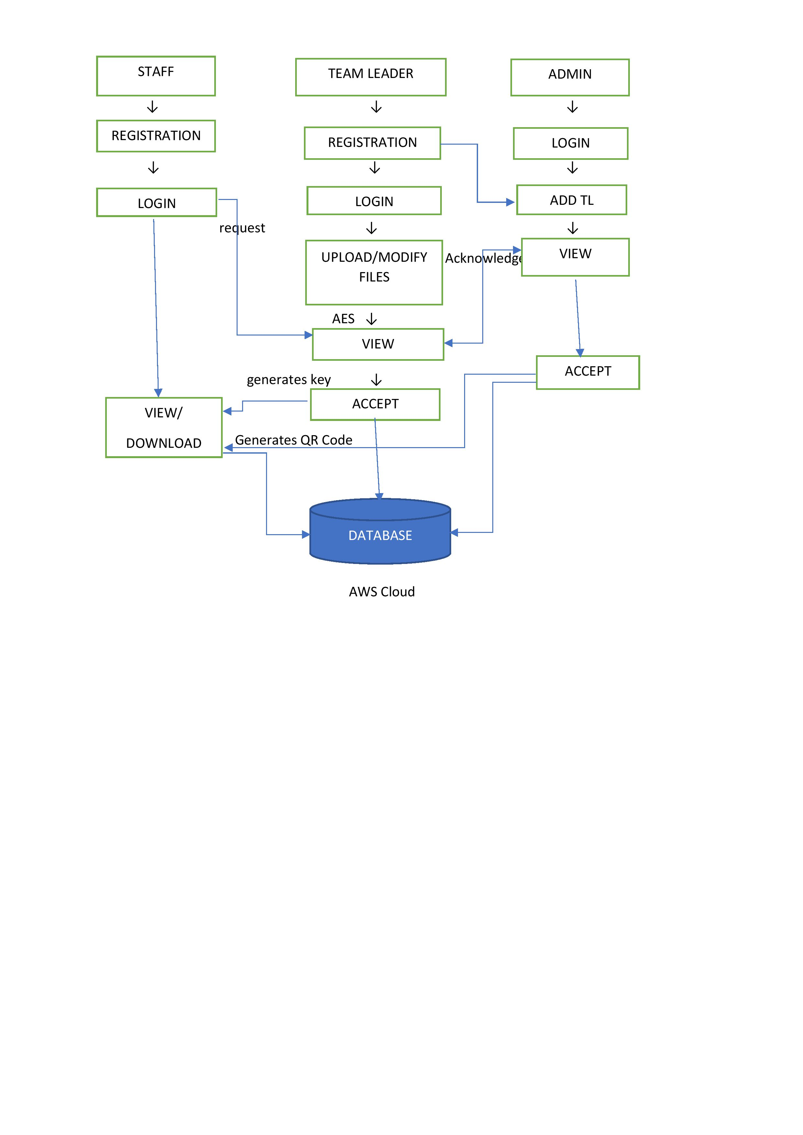
PROCESS ARCHITECTURE

Slide 26
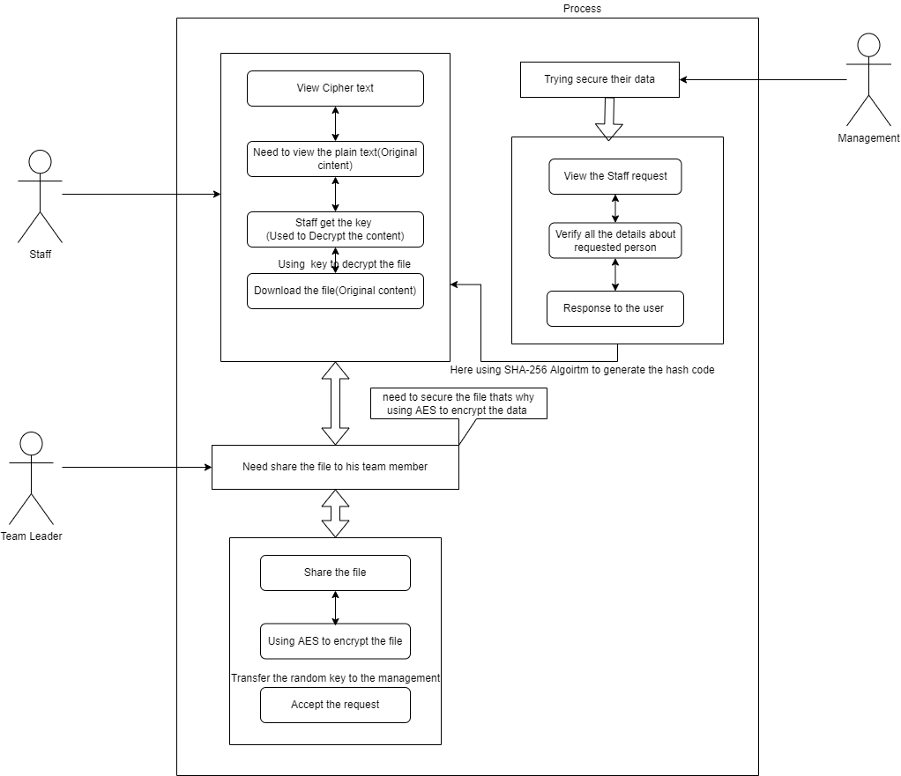
SYSTEM ARCHITECTURE
EXPLANATION:
The systems architect establishes the basic structure of the system, we propose a Hash code Solomon algorithm and we can put a small part of data in local machine and fog server in order to protect the privacy.
Moreover, based on computational intelligence, this algorithm can compute the distribution proportion stored in cloud, fog, and local machine, respectively.
Through the theoretical safety analysis and experimental evaluation, the feasibility of our scheme has been validated, which is really a powerful supplement to existing cloud storage scheme

Slide 27
SYSTEM DESIGN
Use case diagram
Arch Diagram
ER Diagram

Slide 28
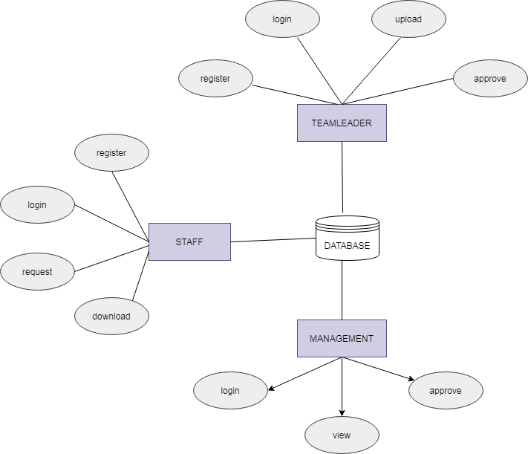
E-R DIAGRAM

Slide 29
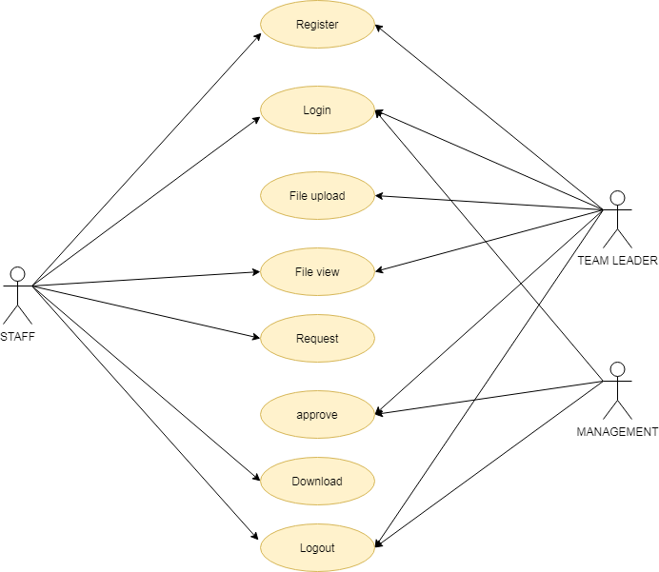
USE-CASE DIAGRAM

Slide 30
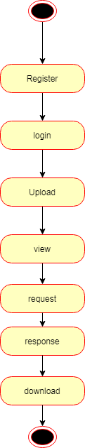
STATE DIAGRAM

Slide 31
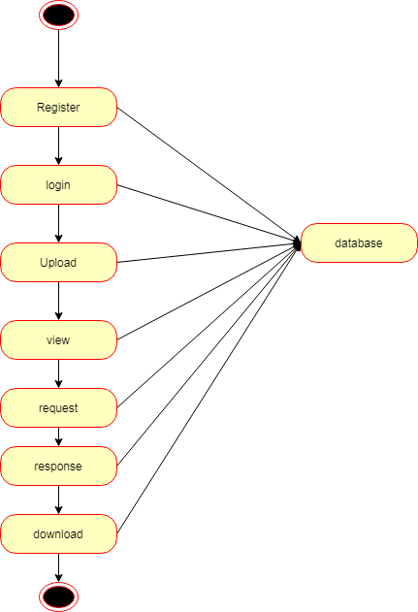
ACTIVITY DIAGRAM

Slide 32
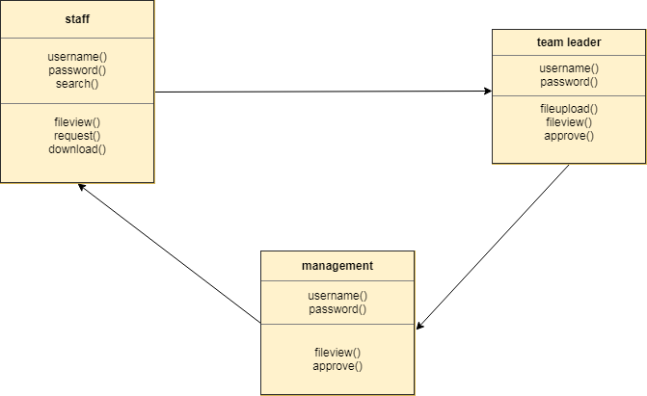
CLASS DIAGRAM

Slide 33
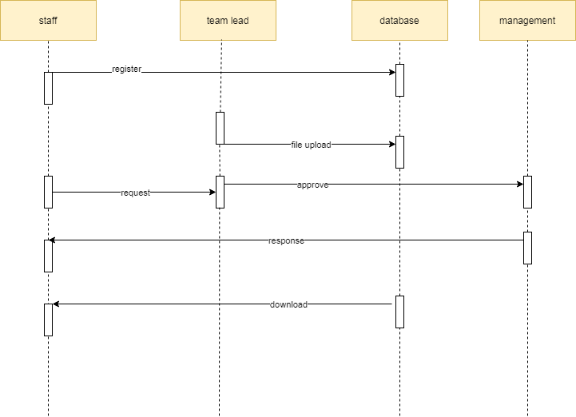
SEQUENCE DIAGRAM

Slide 34
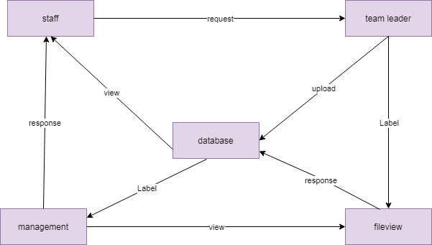
COLLABORATION DIAGRAM

Slide 35

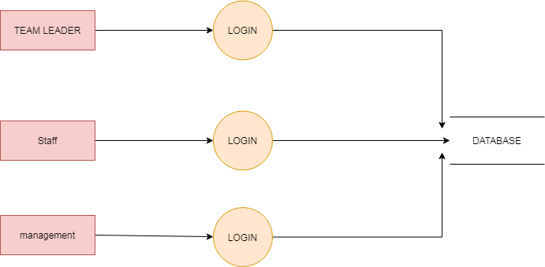
DFD
Level 1:
Level 2:

Slide 36
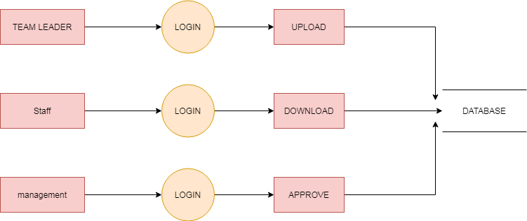
DFD
Level 3:

Slide 37
MODULES
STAFF
TEAM LEADER
FILE ENCRYTION
MANAGEMENT
HASHING AND QR GENERATION
PERMISSION GRANT & APPROVAL

Slide 38
MODULE EXPLANATION
STAFF MODULE
STAFF REGISTER:
The register module provides a conceptual framework for entering data on those staff in a way that: eases data entry & accuracy by matching the staff entry to the data source (usually paper files created at point of care), ties easily back to individual staff records to connect registers to staff data, and collects data elements to enable better supervision of donation programs.
STAFF LOGIN:
In this module in our project, here symbolizes a unit of work performed within a database management system (or similar system) against a database, and treated in a coherent and reliable way independent of other transactions. A transaction generally represents any change in database user will transfer the amount to provider.

Slide 39
MODULE EXPLANATION
STAFF FILE VIEW:
In this module the staff will also view the team leader added file. And analysis the details will be responsible for your file stored in database.
STAFF FILE REQUEST:
In this module is used to help to the staff to Request for download file with the land longitude and the user will update the report along with their opinion and the will be stored the database.
STAFF FILE DOWNLOAD:
In this module the staff download the file after management accept the request. It will be stored on local storage.

Slide 40
MODULE EXPLANATION
TEAM LEADER MODULE
TEAM LEADER LOGIN:
In this module in our project, here symbolizes a unit of work performed within a database management system (or similar system) against a database, and treated in a coherent and reliable way independent of other transactions. A transaction generally represents any change in database user will transfer the amount to provider.
TEAM LEADER FILE UPLOAD:
The team leader can then select a file from their computer and click the Upload button to submit the file to the server. The Java file upload Servlet will then capture that file and persist. It will be stored in database.
TEAM LEADER FILE VIEW:
This module to help us the staff add the file to the staffs. The data directly stored in database. Then staff will view the uploaded file.

Slide 41
MODULE EXPLANATION
FILE ENCRYPTION MODULE
The file to be accessed by the staff is encrypted using AES algorithm.
The file access permission is requested by the staff member.
The partial decryption of the file happens only when the team leader gives the access key.

Slide 42
MODULE EXPLANATION
MANAGEMENT MODULE
MANAGEMENT LOGIN:
In this module in our project, here symbolizes a unit of work performed within a database management system (or similar system) against a database, and treated in a coherent and reliable way independent of other transactions. A transaction generally represents any change in database user will transfer the amount to provider.
MANAGEMENT TEAM LEADER AND MEMBER REGISTRATION:
The register module provides a conceptual framework for entering data on those team leader in a way that: eases data entry & accuracy by matching the team leader entry to the data source (usually paper files created at point of care), ties easily back to individual team leader records to connect registers to team leader data, and collects data elements to enable better supervision of team programs.

Slide 43
MODULE EXPLANATION
HASHING AND QR GENERATION MODULE
Hashing is designed to solve the problem of needing to efficiently find or store an item in a collection.
Note: SHA algorithm is used here to generate hash code while a request is given to find a particular file from a database. Since the permission request differs from one staff to another , different hash codes are generated making the access grant integrated
QR code generation happens when the user wants the approval for access of a file by management.
QR code generation is done using Jquery.
The Team leader key along with the QR is used to decrypt the file for the Staff to view it.
Blockchain : It is used in access request and grant permission for validating and tracing the details of the requested person (decryption).

Slide 44
MODULE EXPLANATION
PERMISSION GRANT AND APPROVAL MODULE
MANAGEMENT GENERATE KEY:
In this module the management generate key for the staff request. Because the key for the security purpose. After get the key from management the staff will download the file with key.
MANAGEMENT RESPONSE:
In this module the bank will response the data file fully analyzed data in category wise view Bank will be responsible for your file stored in database.

Slide 45
MODULE DIAGRAM
Staff Register:
DATABASE
STAFF
REGISTER
Staff Login:
DATABASE
STAFF
LOGIN
HOME PAGE

Slide 46
MODULE DIAGRAM
Staff File View:
DATABASE
STAFF
VIEW FILE
Staff File Request:
DATABASE
STAFF
REQUEST
REQUEST VIEW
Staff File Download:
DATABASE
STAFF
DOWNLOAD
LOCAL STORAGE

Slide 47
MODULE DIAGRAM
Team Leader Login:
DATABASE
TEAM LEADER
LOGIN
HOME PAGE
Team Leader File Upload:
ADD FILE
DATABASE
TEAM LEADER
Team Leader File View:
DATABASE
TEAM LEADER
VIEW FILE

Slide 48
MODULE DIAGRAM
Management Login:
DATABASE
MANAGEMENT
LOGIN
HOME PAGE
Management – Team Leader Registration:
DATABASE
MANAGEMENT
ADD TEAM LEADER
TEAM LEADER LOGIN

Slide 49
MODULE DIAGRAM
Management – Generate Key:
MANAGEMENT
GENERATE KEY
STAFF
Management Response:
MANAGEMENT
RESPONSE
DATABASE
STAFF

Slide 50
ALGORITHM EXPLANATION
SHA Algorithm
AES Algorithm
In the field of cryptography and crypt analytics, the SHA-1 algorithm is a crypt-formatted hash function that is used to take a smaller input and produces a string that is 160 bits, also known as 20-byte hash value long. The hash value therefore generated, is known as a message digest which is typically rendered and produced as a hexadecimal number which is specifically 40 digits long.
The AES Encryption algorithm (also known as the Rijndael algorithm) is a symmetric block cipher algorithm with a block/chunk size of 128 bits. It converts these individual blocks using keys of 128, 192, and 256 bits. Once it encrypts these blocks, it joins them together to form the ciphertext.

Slide 51
DATA DICTIONARY
AWS – Amazon Web Server
RDS – Relational Database Service
RSA – Rivest Shamir Adleman
DSA – Digital Signature Algorithm
AES – Advanced Encryption Standard
SHA – Secure Hash Algorithm
QR code – Quick Response Code
DFD – Data Flow Diagram
ER Diagram– Entity Relationship Diagram
UML Diagrams – Unified Modelling Language
UI Design – User Interface Design
OS – Operating System
RAM – Random Access Memory
IDE – Integrated Development Environment
HTML – Hyper Text Markup Language
CSS – Cascading Style Sheets
Js – JavaScript
GB – Giga Bytes

